Slide 1
CONGLETON NEIGHBOURHOOD PLAN
27TH April 2017
Andrew Thomson
Planning Consultant

Slide 2
Development Plans in Cheshire East
Local Plan Part 1 – EIP complete, consultation on main modifications now complete, likely adoption July 2017
Consultation has just finished on the SADPD Issues Paper and Call for Sites which will eventually form Part 2 of the Local Plan. Likely adoption late 2018
Neighbourhood Plans – 4 made
CIL – late 2018

Slide 3
What has happened so far?
We have held a series of consultation events
We have sent out a number of questionnaires and listened to what you have said
We have held a public meeting
We have spoken to local businesses and listened to their concerns
We have spoken to local developers who have an interest in the town
We have listened to the local community
We have as a Steering Group met on a regular basis gathering evidence and reporting back to the Town Council.
We have drafted some policies.

Slide 4
What are the next stages?
The draft policies are almost complete and we need to ask Cheshire East whether the Plan requires a Strategic Environmental Assessment. This normally takes 4-6 weeks.
The Plan will then be subject to a Regulation 14 Consultation which we undertake.
This takes 6 weeks and we will need to review and possibly amend the Plan depending upon the responses received.
Once reviewed, the Plan together with a Statement of Consultation and Statement of Basic Conditions is submitted to Cheshire East under Regulation 15 who re-consult for a further 6 weeks and then organise and pay for the examination and referendum.

Slide 5
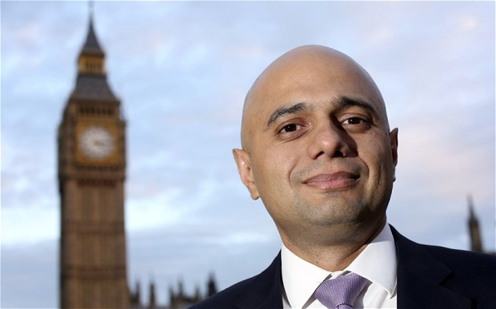
Neighbourhood Plans and Planning Appeals

Slide 6
Neighbourhood Plans and Community Infrastructure Levy

Slide 7
Frequently asked questions
Why are we doing this?
Will it stop development?
When will we have a plan?
How much will it cost?
Will it reduce traffic through the town?
Who examines the plan?
Who pays for the referendum?
What happens when the plan is ‘made’?

Slide 8
This is why you should create a Neighbourhood Plan for Congleton
It is your community.
You are the people who live here, you are the people who have to use the services, you are the people whose children go to school here.
You have the real understanding of what you need and what you expect for the future.
Therefore, it is absolutely fundamental that the community are at the heart of the neighbourhood plan process."

